Slide 1
NYPD Database
2006 - 2022

Slide 2
Introduction
Objective
Analyze NYPD database
2006-2022
R studio

Slide 3
Preprocessing
Source: NYPD Shootings Incidents dataset from NYC Open Data
Libraries: tidyverse, lubridate, dplyr, ggplot2, xgboost, caret, pROC, ROCR, reshape2
Data Cleaning
Selecting relevant columns
Evaluate and remove missing data
Convert date/time to proper formats
Extracted the year

Slide 4
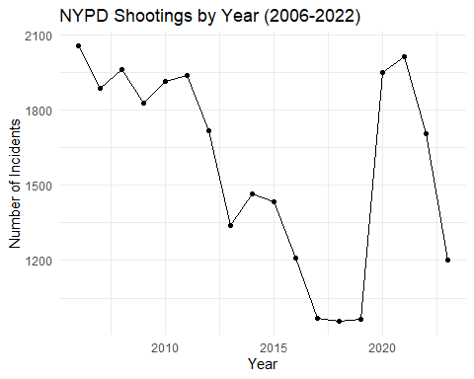
Exploratory Analysis
Total shootings by year
Decrease around 2017 till 2019
Increase in 2020
Then a decrease in the years following

Slide 5
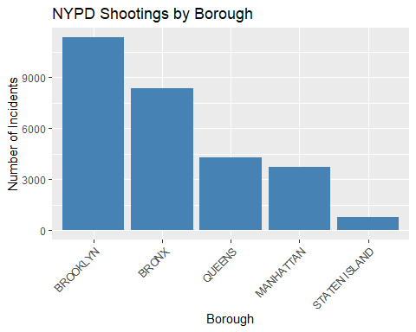
Exploratory Analysis
Shooting by Borough
Brooklyn and Bronx are the highest
Staten Island is the lowest

Slide 6
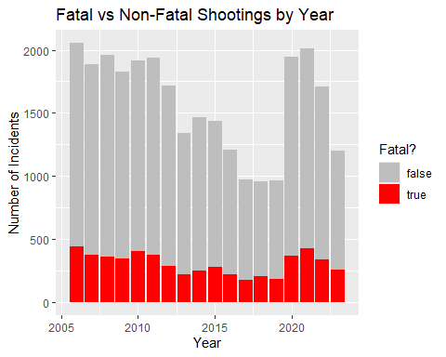
Exploratory Analysis
Fatal vs Non-Fatal by Year
While some variations, remain stable

Slide 7
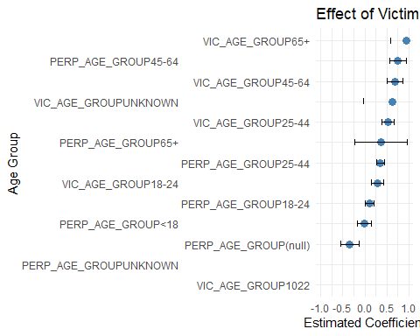
Statistical Analysis
Age of the Victim and Perpetrator
Older victims more likely to die
Older age are more likely to be the perpetrator

Slide 8
Statistical Analysis
65% of shootings occur in Brooklyn and Queens
2.7% of shootings occur in Staten Island
Victims aged 65 are 3.18 times more likely to die from a shooting incident

Slide 9
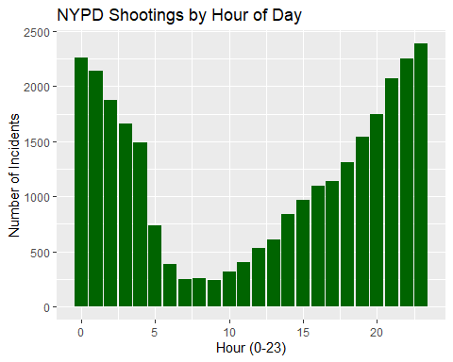
Statistical Analysis
Shooting by Hour
“Bimodal” distribution
Midnight and 3 AM
6 PM and 11PM

Slide 10
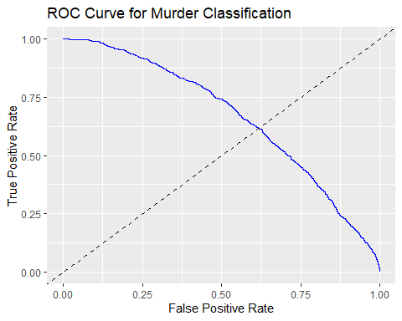
Statistical Analysis: Machine Learning
Receiver Operating Characteristic
The curve shown appears to be close to the diagonal, suggesting the model might not be performing well in distinguishing between classes.

Slide 11
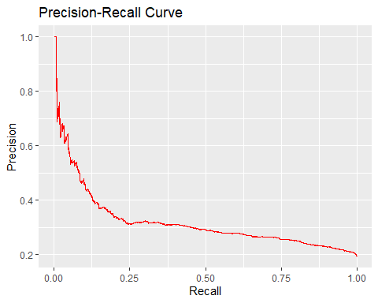
Statistical Analysis: Machine Learning
Precision-Recall (PPV-Sensitivity)
Precision is initially high when recall is low.
As recall increases, precision drops sharply
The model's precision quickly drops and remains relatively low

Slide 12
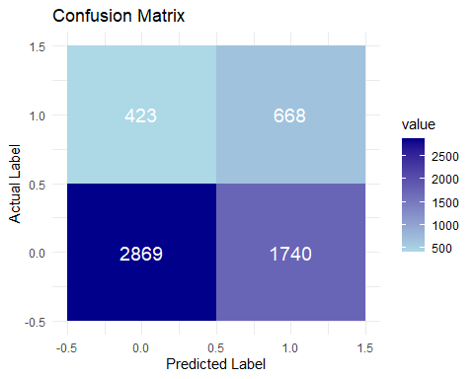
Statistical Analysis: Machine Learning
Confusion Matrix
The model struggles to correctly identify positive cases.
The model is less likely to misclassify negative cases as positive.
Accuracy: 37.95
F1 score: 49.59%

Slide 13
Conclusions

